Slide 1
Prediction of pollution by using Rapid miner

Slide 2
Pollution is increasing day by day and it is the main factor for many health problems .
By using this data we can predict the pollution by county wise with the help of decision tree algorithm we can predict the pollution by county wise.

Slide 3
Data:
The data sets are taken from kaggle.com
The attributes includes state code, country code, site number.

Slide 4
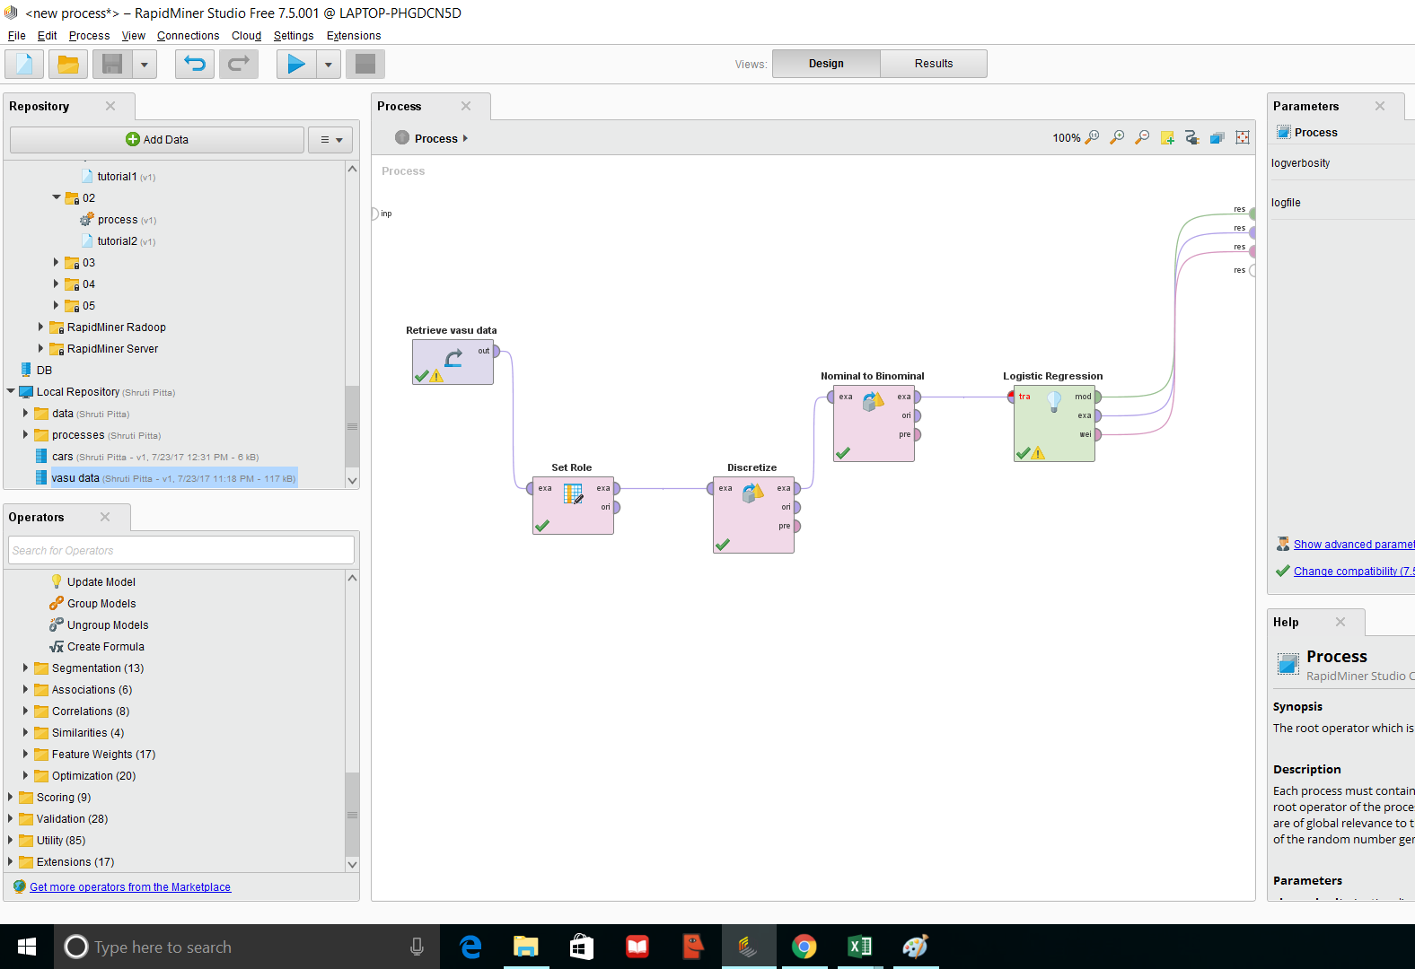
Methodology:
By using rapid miner tool we can predict the pollution by applying algorithms like logistic regression and decision tree.
The data is extracted, transformed, and loaded using rapid miner.
Using logistic regression and decision tree methodology the cube is formed and deployed to get the analytical results
Later with the deployed cube the reports can be generated, for further deep understanding of the data that is been used.

Slide 5
Methods:
Logistic regression:
Logistic regression is used to describe data and to explain the relationship between one dependent binary variable and one or more nominal, ordinal, interval or ratio-level independent variables.
Decision tree:
Decision tree is defined as graph that uses branching method to illustrate every possible outcome of a decision.

Slide 6
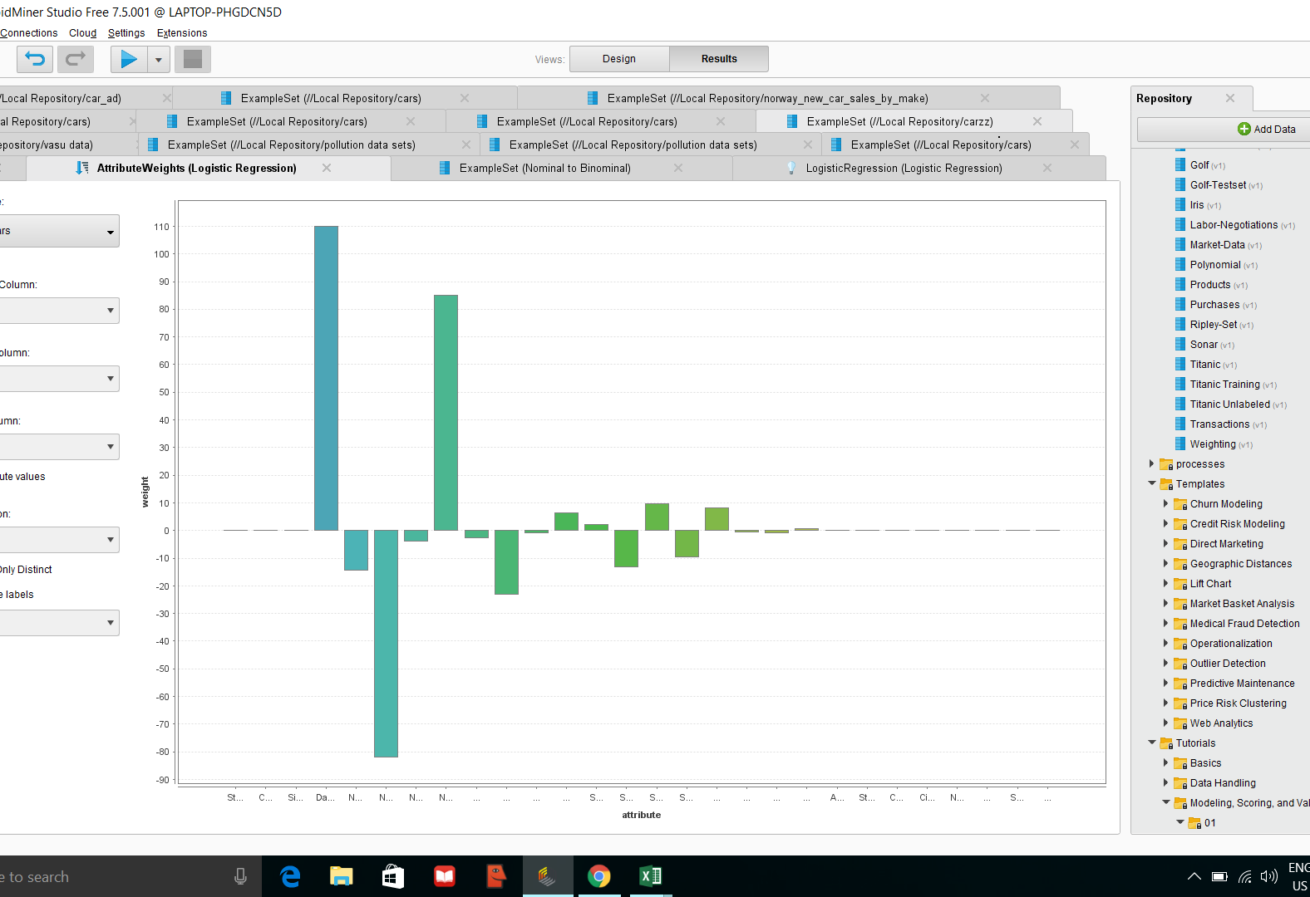
Results: logistic regression

Slide 7
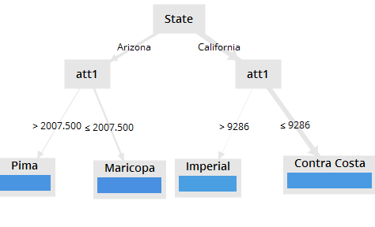
Decision tree result

Slide 8
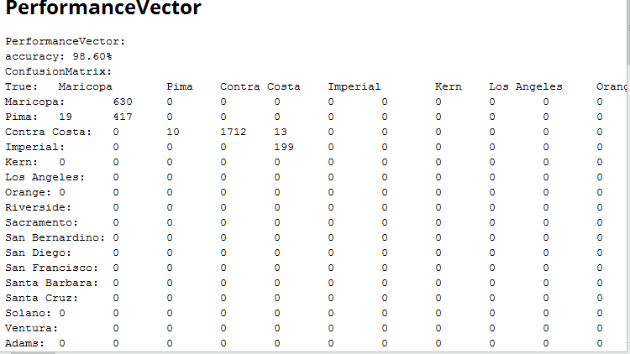
The below chart explains the results which shows 98.60 percent accuracy.

